Slide 1

Cartem’s Donuts Franchise Opportunities
Kristina Perit
January 11th, 2020

Slide 2


Introduction
The gold standard for donuts, Tim Hortons, has failed to capture the Millennial market
Tim Hortons has adopted the “lowest common denominator” of food quality

Slide 3
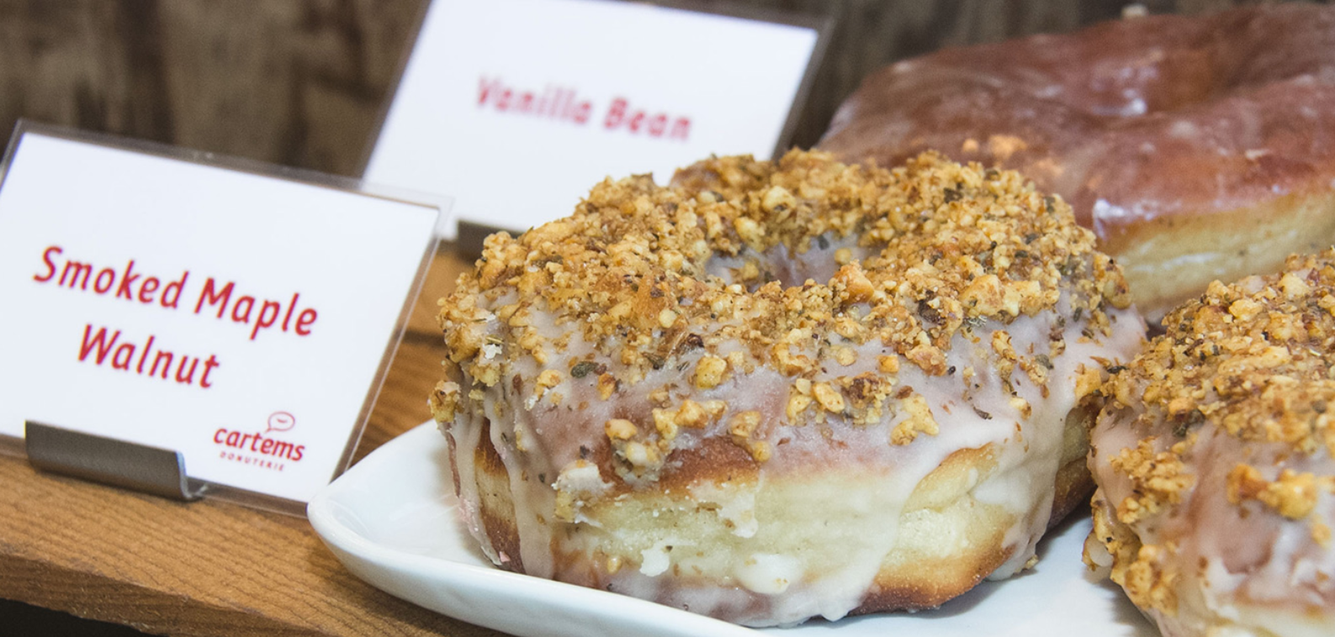
Cartem’s Donuts
Beloved Vancouver donut chain making handmade donuts from fresh, natural ingredients
Includes coffee, gluten friendly, and vegan options

Slide 4
Opportunity
Cartem’s Donuts quality product and Canadian brand could capture the Millennial Market
Toronto is a prime market for expansion with a Millennial population of ~1.26 million
But where in Toronto would Cartem’s Donuts expand to?
In this presentation I will outline appropriate Toronto neighbourhoods for new locations

Slide 5
Methods
To predict the best neighbourhoods for Cartem’s Donuts locations I looked at the following data:
In Toronto neighbourhoods:
Millennial population
Current gluten free and vegan options
Accessibility by subway
Neighbourhoods with a large Millennial population that are accessible by subway but lacking in gluten free and vegan options will be the best opportunities!

Slide 6
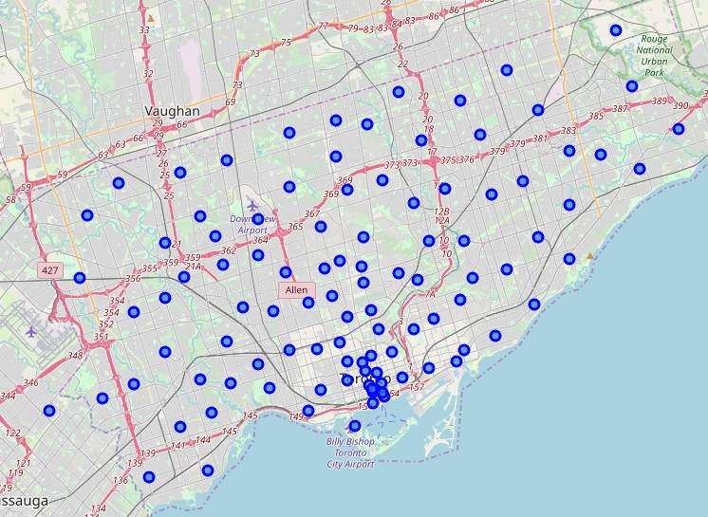
Results:
Toronto neighbourhoods:

Slide 7
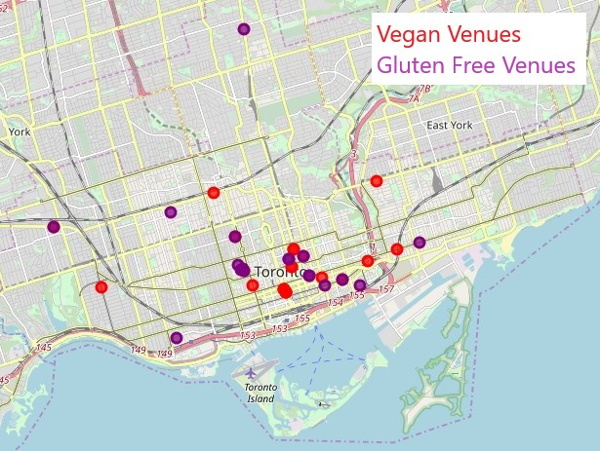
Results
Current vegan and gluten free options in Toronto are clustered around downtown:

Slide 8
Results
Neighbourhoods with the highest Millennial populations:
Postal Code | Neighborhood | Millenial Population | Gluten Free | Vegan | Subway Station
M1G | Woburn | 12075 | N | N | Y
M1H | Cedarbrae | 12075 | N | N | Y
M2M | Newtonbrook, Willowdale | 15365 | N | N | Y
M4Y | Church and Wellesley | 14045 | N | N | Y
M5B | Ryerson, Garden District | 14045 | Y | Y | Y
M5C | St. James Town | 14045 | Y | Y | Y
M5J | Harbourfront East, Toronto Islands, Union Station | 34850 | N | N | Y
M5S | Harbord, University of Toronto | 13385 | Y | Y | Y
M5V | CN Tower, Bathurst Quay, Island airport, Harbo... | 34850 | N | N | Y
M6G | Christie | 11235 | Y | N | Y
M6H | Dovercourt Village, Dufferin | 11235 | N | N | Y
M6K | Brockton, Exhibition Place, Parkdale Village | 15690 | Y | N | N

Slide 9
Discussion
Winning neighbourhoods!
Postal Code | Neighborhood | Millenial Population | Gluten Free | Vegan | Subway Station
M1G | Woburn | 12075 | N | N | Y
M1H | Cedarbrae | 12075 | N | N | Y
M2M | Newtonbrook, Willowdale | 15365 | N | N | Y
M4Y | Church and Wellesley | 14045 | N | N | Y
M5B | Ryerson, Garden District | 14045 | Y | Y | Y
M5C | St. James Town | 14045 | Y | Y | Y
M5J | Harbourfront East, Toronto Islands, Union Station | 34850 | N | N | Y
M5S | Harbord, University of Toronto | 13385 | Y | Y | Y
M5V | CN Tower, Bathurst Quay, Island airport, Harbo... | 34850 | N | N | Y
M6G | Christie | 11235 | Y | N | Y
M6H | Dovercourt Village, Dufferin | 11235 | N | N | Y
M6K | Brockton, Exhibition Place, Parkdale Village | 15690 | Y | N | N

Slide 10
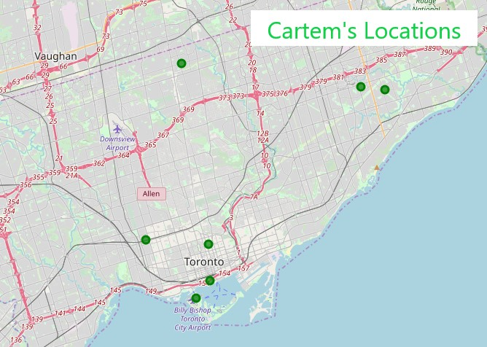
Discussion
Map of new Cartem’s Donuts locations:

Slide 11
Conclusions
Cartem’s Donuts has a unique opportunity to profit from Tim Horton’s loss
The Millennial market in Toronto is ready for quality, Canadian donuts and coffee
7 neighbourhoods in Toronto are great opportunities for new locations
Once the new locations are generating sales the model can be updated and improved for future expansion

